Slide 1
Regular Expressions
Session Ten
Notes:
Welcome to our tenth session! You have made it through the midterm. We are valiantly working to catch up on grading so that we have all work graded this week.

Slide 2
Reminders
Due Today
Due Next Week
Nothing
Nothing – start working on project
Quiz on this session’s content
Notes:
There is nothing due today – exciting!
Please listen and take these words seriously. You have “nothing” due next week but that does NOT mean you should do no homework this week. I highly encourage you to take the same # of hours you have been devoting to homework and devot it to starting your project. We will do an intro to the project in a moment but I want to stress up at the top of class that if April or I were to do such a project it would take us a couple of full work days so for beginner or intermediary programmers the project CANNOT be done in a day or two. Please please get started on your project this week.
Next week you will have your final quiz in class.

Slide 3
Agenda / Topics
1. Intro, Project Intro, & Midterm Review
2. Standard Library
3. Regular Expressions
4. Break
5. Security Topic
6. Overflow / Q&A / Dismissal
6:30 - 7:10
7:10 - 7:40
7:40 - 8:00
8:00 - 8:15
8:15 - 8:45
8:45 - 9:00
Notes:
Today we’ll have a q&a to answer any last-minute burning questions from last week and then we’ll be doing the practice quiz. After that, we’ll start the lecture. We’ll cover a handful of topics with a break at 8 pm and we’ll wrap the class up before 9 pm.

Slide 4
Q&A
?
Notes:
Any last-minute questions before the quiz?

Slide 5
Midterm Review

Slide 6
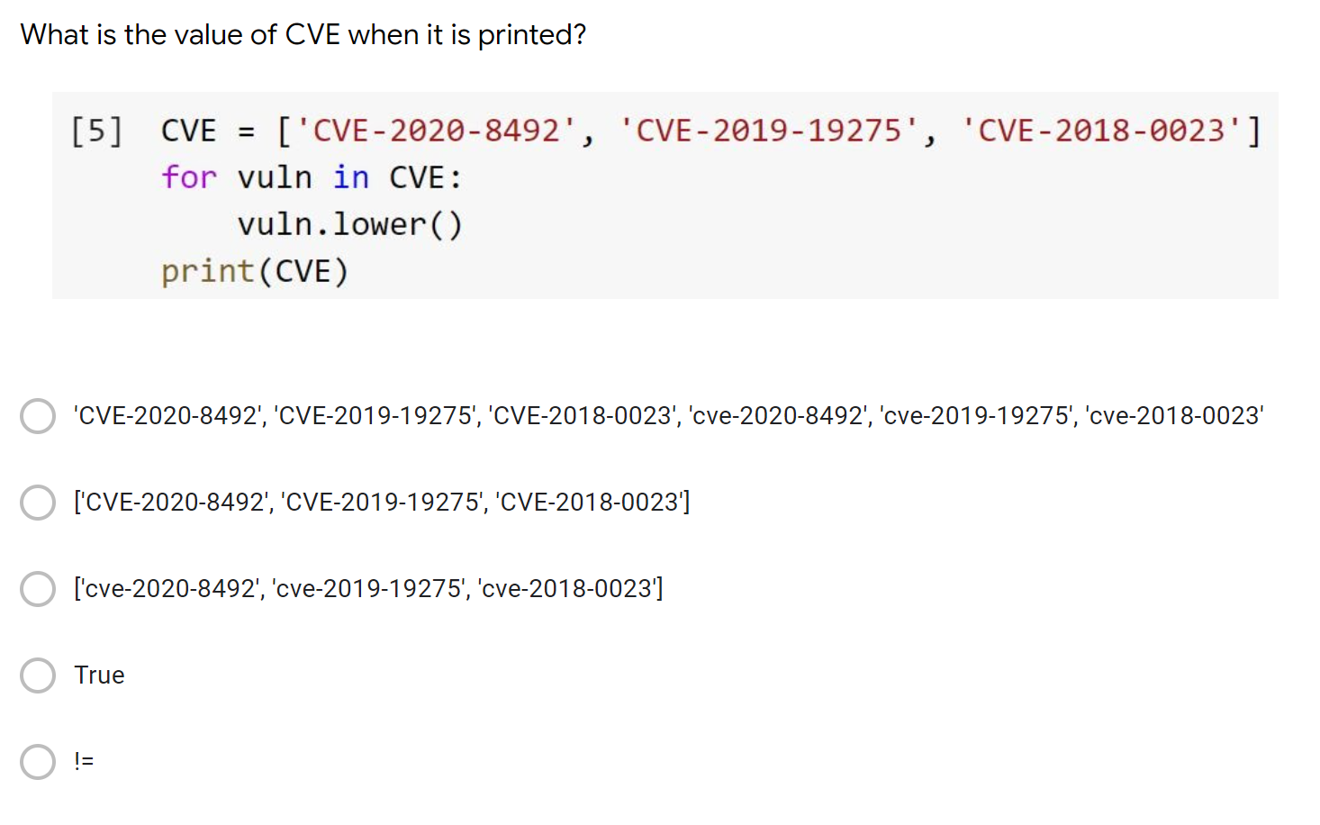
What is the value of CVE when it is printed?

Slide 7
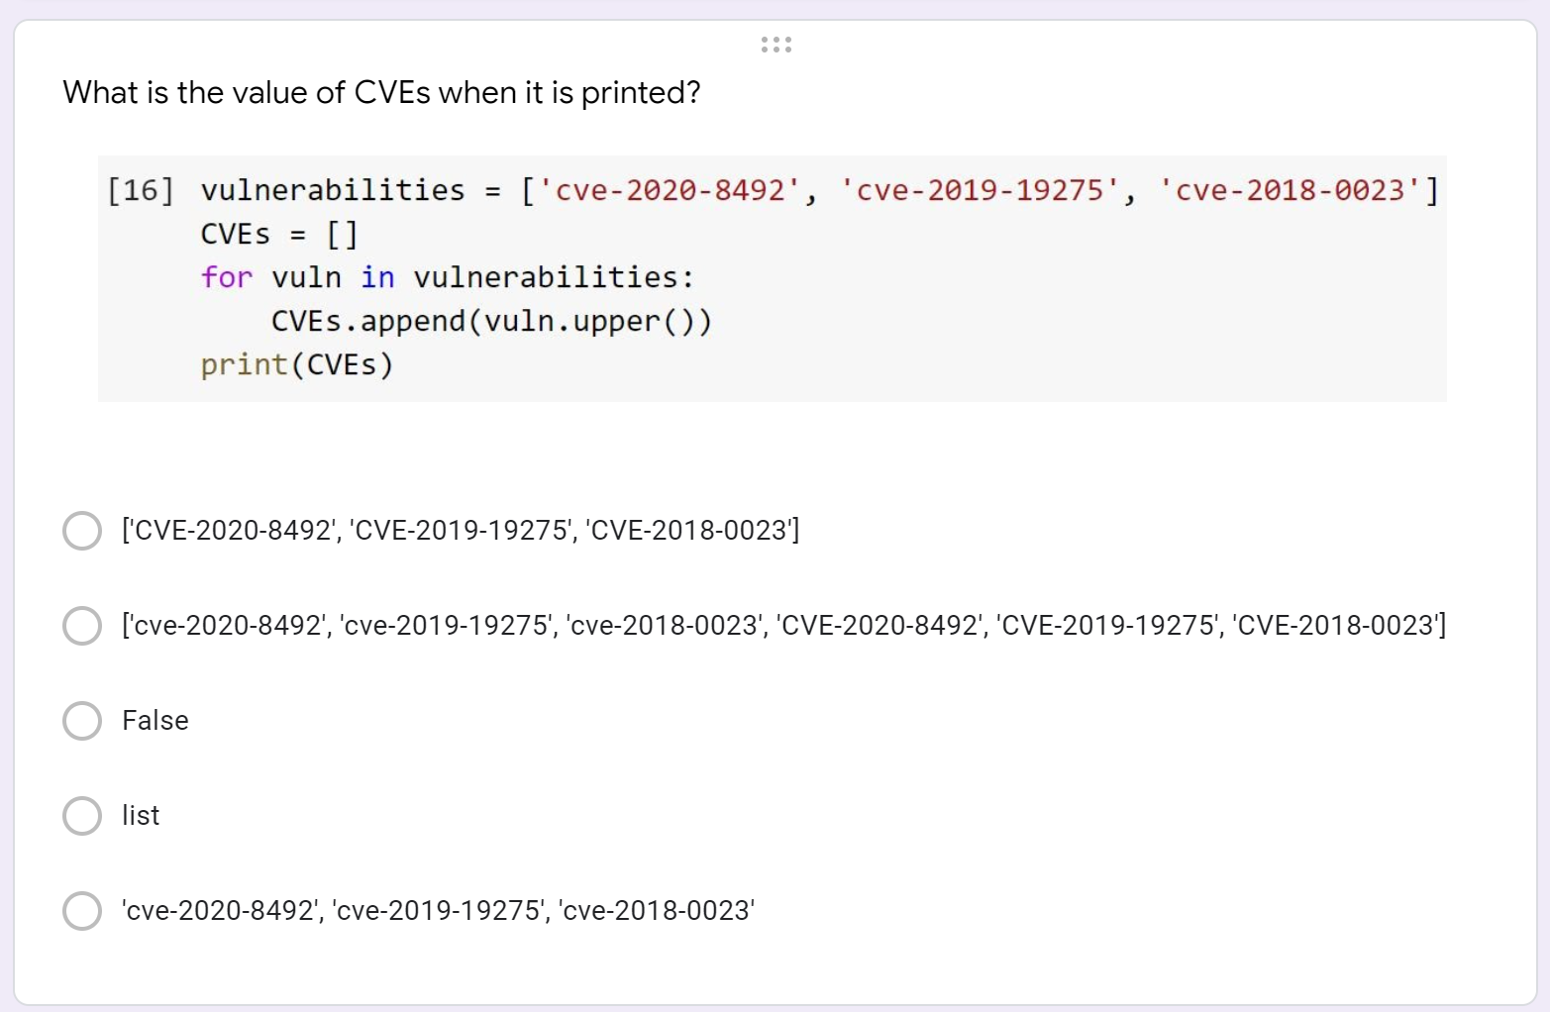
What is the value of CVE when it is printed?

Slide 8
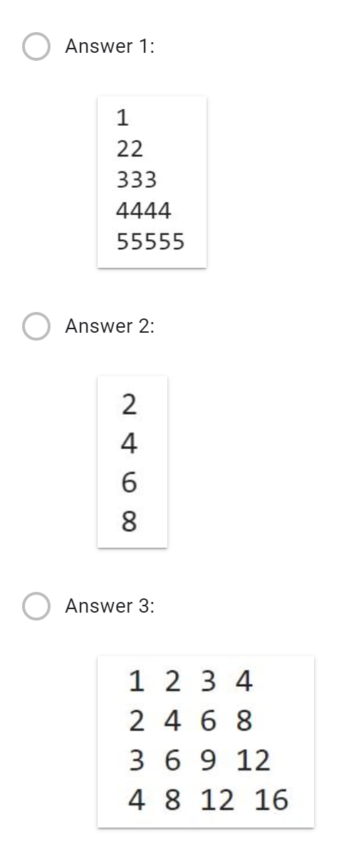
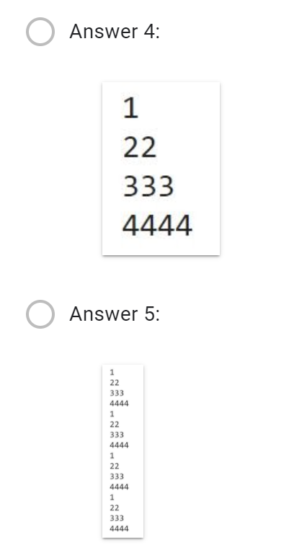
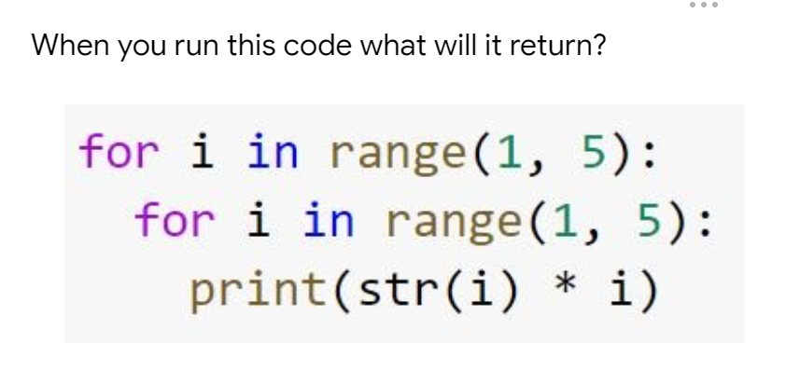
What will this code return?

Slide 9
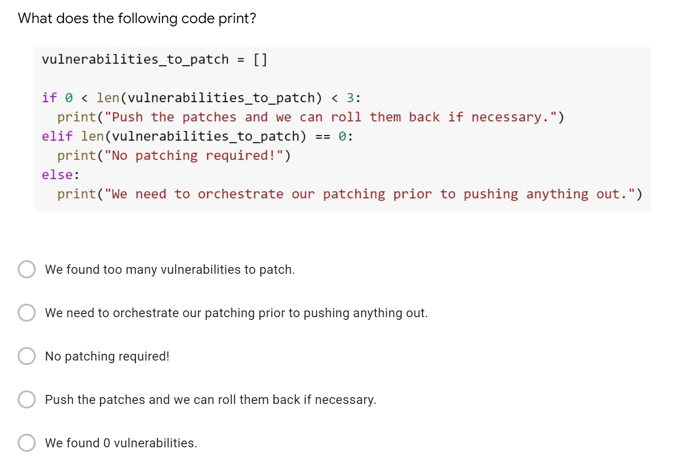
What does the following code print?

Slide 10
Project Overview

Slide 11
Project Logistics
Format
There will be three components to your project:
PIRs with explanation of which question you plan to address & collection requirements with explanation of which VirusTotal data sources you plan to use to address your question
Deepnote notebook of code which gets you the data you need to answer your question
Deepnote notebook or Google Doc containing a piece of intelligence writing which answers your question and references data you pulled using your notebook
Due Dates
Project Part 1 - November 16, 2020
Project Part 2 – November 30, 2020

Slide 12
Project Part 1
Goals
Document a set of PIRs and select one of those questions to address through your project.
Document the exact data sources within VirusTotal which you will plan to use to address your question.
Approach
To be successful you MUST get really familiar with the VirusTotal API documentation so that you understand what data is available to you.
Understanding what data is available to you will enable you to craft an answerable question.
You will likely need to do some OSINT research to find some seed ideas from which to build your PIRs.

Slide 13
Project Part I1
Goals
Write a notebook which provides you the data you need to answer your question.
Write an intelligence report which addresses the PIR you set out to answer.
Approach
Pseudocode, pseudocode, pseudocode.
This will be your first time working with a real, live, complex dataset via an API. You / we will undoubtedly run into unexpected situations and it will be important for you to surface these to us quickly.
You will be the only person in the world who has done this unique research and you should assume we are not familiar with it beyond what you communicate to us in your report. Therefore, you must write your report to be comprehensive, clear, and evidence-based.

Slide 14
Regular expressions aka Regexes

Slide 15
Regexes
Regexes enable us to find patterns in text!
Regexes are not a programming language they are a standardized syntax which is used across programming languages.
In order to access regexes within a python notebook you need to import the regex module which is called “re”.
Example usage:
import re
^(?:[0-9] {1,3}\.){3}[0-9]{1,3}$
Notes:
Regexes are not specific to Python but can be leveraged using python. A regex is a sequence of characters that define a search pattern. Usually regexes are used by string-searching algorithms for "find" or "find and replace" operations on strings, or for input validation. Said more simply regexes are fancy searches.
Regexes are not python specific but they can be used within python notebooks. To access regexes within a python notebook you need to import the regex module which is called “re.”
So knowing that they are used to recognize patterns. Let’s talk through this example on the left. This daunting looking regex can help you to identify an IP address. Knowing that can someone please verbally walk me through what you think the regex might mean going character by character? Okay, later on I am going to ask you to make this regex better because this specific regex might identify an IP address but it might not.

Slide 16
What is a standard computer / word processor feature which we have all used which is just a UI on top of a basic regex?
Notes:
Answer: control, find

Slide 17
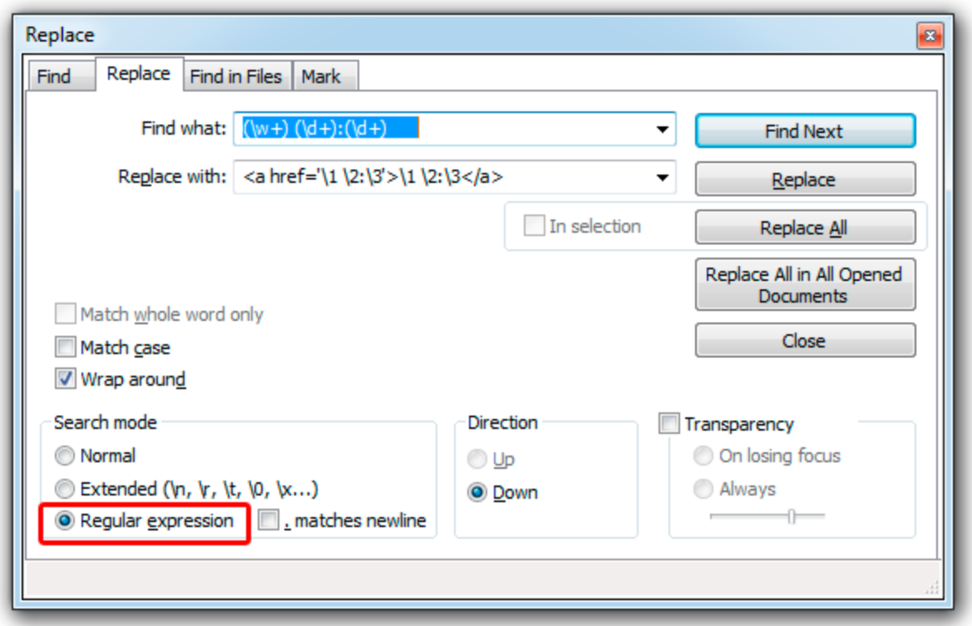
Some Text Editors Enable Regex Usage
Notes:
[Lauren] Many text editors, such as Notepad++ shown on the slide here, even have a regex option so that you can use the find and replace functionality more nimbly.

Slide 18
Regex Basics
Basics
Quantifiers
Special Characters
^ | Start of string
$ | End of string
. | Wildcard one character
| | Or
\ | Escape a special character
* | Wildcard
? | Match 0 or 1
+ | Match 1 or more
{#} | Match exactly #
{#,#} | Match everything between # and #
\n | Newline
\d | Digit
\D | Non-digit
\s | Whitespace
\S | Non-whitespace
Notes:
[Lauren] There are lots of regex cheat sheets online. I recommend finding a few that are really helpful to you and committing them to memory. For example I find $ and /n to be really helpful so that I can add or remove things from the end of a line. This helps a lot when I want to add commas between items.

Slide 19
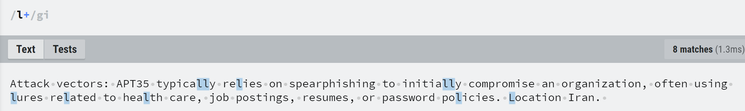
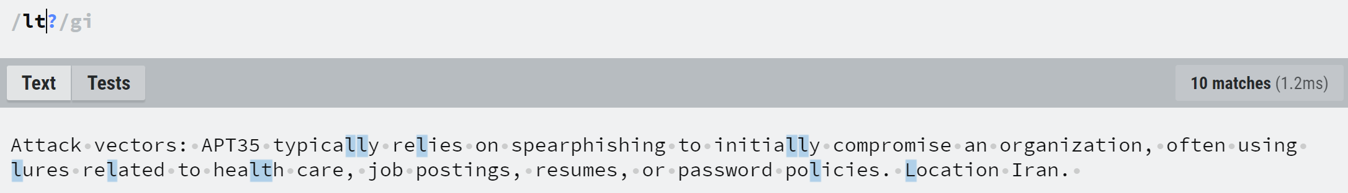
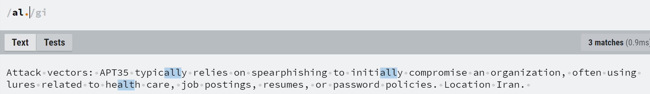
Quantifiers
Notes:
[Lauren] As you start to practice using regexes I suggest using a site such as https://regexr.com/ to try out different keywords and combinations. Regexr allows you to put in some text, write a regex, and as you write it will highlight the components of the text which the regex is picking up.
In this first example you will see that use of the + sign in a regex will find 1 or more of that thing so in this example it has highlighted all of the ls including the double ls. Also, note that it has highlighted both lower case and upper case l. That’s because I used the regex flag i to mean case insensitive.
In the second example you can see that I used the ? this means search with this as an optional criteria. So here you will get all singular letter ls highlighted and also all lts highlighted.
The . period is an important wildcard. Wildcards are a common tool in programming which enable you to say give me anything. For example, the regex period wildcard is going to give you any one character. So in the third example on the screen you will see that I am looking for the characters al followed by any one character which means that both all and alt each get highlighted.

Slide 20
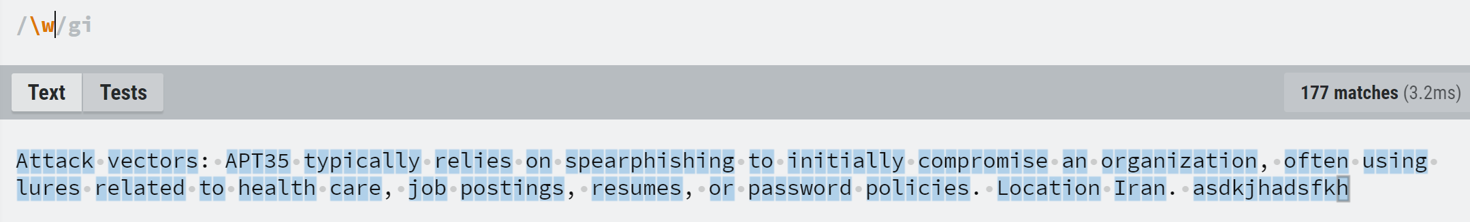
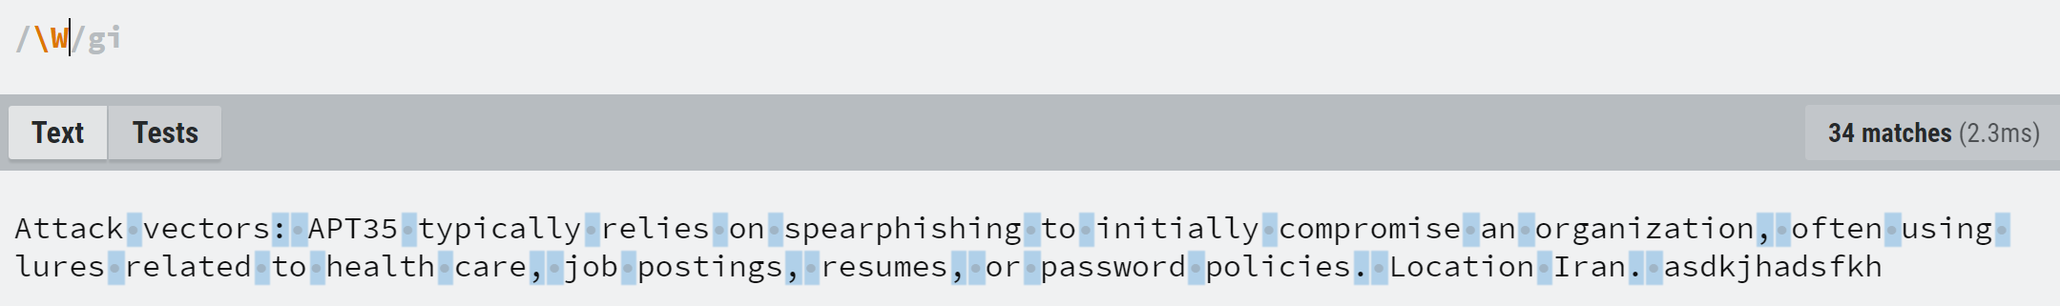
Special Characters
Notes:
[Lauren] One of the helpful things about special characters is that for each special character if you use the capitalized version of the letter it will do the opposite of whatever the lower case special character does. For instance, \w will highlight the word characters whereas \W will highlight the non-word characters. As you can see in the first example, regexes don’t actually know which words are in the dictionary so it is just looking for anything which could be a word meaning anything that’s a bunch of alphabet characters with no interrupting white space or punctuation.
I’m not going to walk through examples of every special character type because now you get how they work. Some helpful ones are \d which finds digits and \s which finds whitespace.

Slide 21
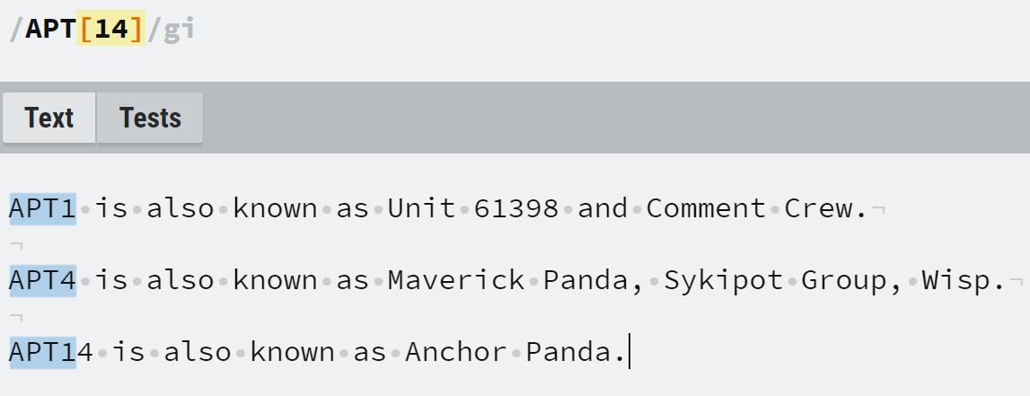
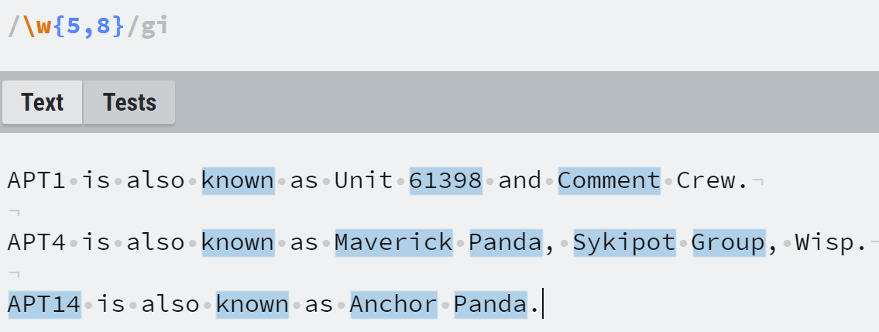
Combining the Quantifiers and Special Chars
Notes:
[Lauren] Regexes start to get complex as you start to combine various regex elements.
The square brackets are the equivalent of an OR statement, in this example it will match on APT1 or APT 4 but you will see that for APT 14 it only highlighted the APT1 portion. There are multiple ways we could get it to capture the whole number 14.
The curly brackets {} enable us to find a range so the second example reads find me all words which are between 5 and 8 characters long.

Slide 22
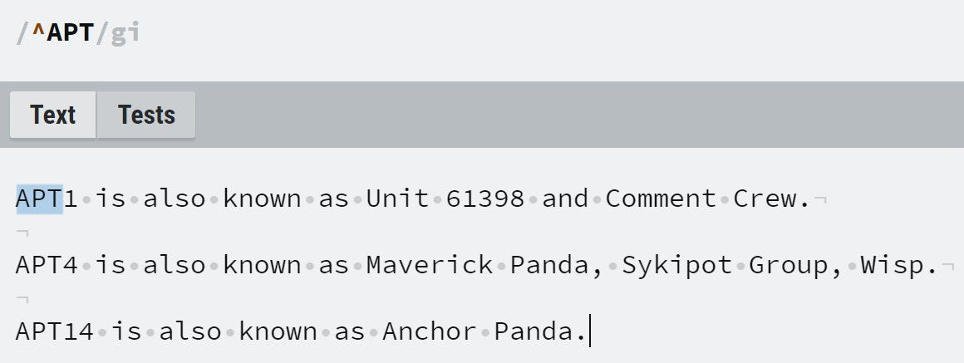
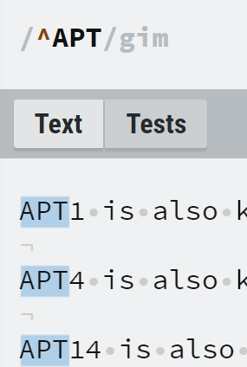
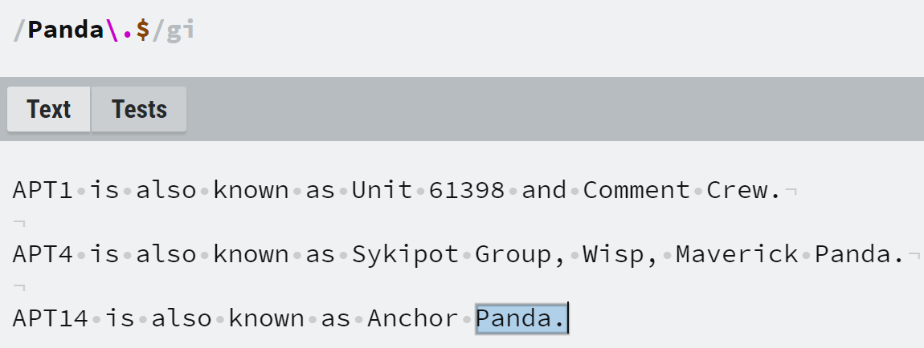
More Regex Terms
Notes:
[Lauren] A few more helpful regex terms are the carrot ^ which means start of the string. In this example I am saying “Give me only the first usage of the term APT in this text. We can see that APT is the first term on each line so it would have been reasonable to assume it would highlight each. To do this we need to add an additional regex flag in to use m which means multiline. This will run the regex on each line and not assume that it is all one continuous string.
The $ will function the same way as the ^ but it will look for terms at the end of the string. You will see in this second example that I used the \ backslash before the period. This is because in this case I am not looking to use the period as a wildcard I want to literally find the period. If I just type period it will interpret it as a wildcard so I use an escape, the backslash, to indicate I want this character read literally.

Slide 23
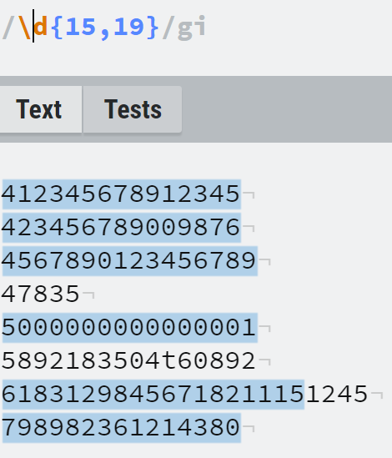
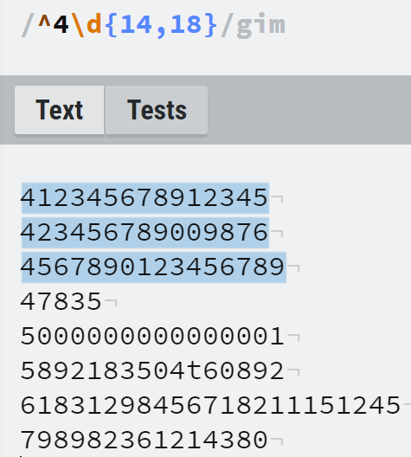
Let’s Steal Credit Card Numbers!
Notes:
[Lauren] Let’s say I’m on the Visa anti-abuse team and I’m told that my job is to figure out as much as I can about how a bunch of our cards have been stolen. I go onto a dark web carding forum, which is the term for a marketplace for stolen credit cards, and now I’m faced with tens of thousands of cards. How am I going to search through these to try to discern any sort of relevant pattern to understand what’s going on.
First, I know that credit card numbers are between 15 and 19 digits long so I want to just get rid of all numbers that can’t be credit cards.
Then I want to figure out which of the cards are Visa cards. As it were the first digit of a credit card indicates the industry that’s issuing the card. Visa is 4. Easy, let’s use ^4 to find all card numbers which start with four. The thing is though that when we first try this using the {15,19} we don’t get the results we expected and that’s because its not counting the 4 in the total length so if we want a total length between 15 and 19 we need to use {14,18} and it will add the 1 character of the 4. Great, so now we have our visa cards.
Great, I extract all of the Visa cards. Now the next thing I know about credit card numbers is that the first 6 digits uniquely represent the issuer identification number. I want to check to see if there are any particular issuers whose cards have been stolen. I look at our three here and can immediately see they don’t match...but let’s say they had, we could then start to ask ourself some questions around whether a particular bank had experienced a breach or whether the cards were all associated with a bank in a particular region and therefore the breach could be of a particular regional store… This is how your analysis could start.

Slide 24
Ctrl F but make it Python!
Method | Explanation
match() | Finds a specific pattern ONLY IF it appears at the beginning of the text.
search() | Finds the first instance of a pattern match anywhere in the text but ONLY finds one.
findall() | Finds all of the pattern matches in the text.
split() | Separates the source material at every part of the text which matches the pattern.
Notes:
[Lauren] The re module contains a number of methods which can help with your advanced control f operations. For example:
match() = finds a specific pattern only at the beginning of the text.
search() = finds the first instance of a pattern match anywhere in the text but only finds one.
findall() = finds all of the pattern matches in the text.
split() = separates the source material at every part of the text which matches the pattern.

Slide 25
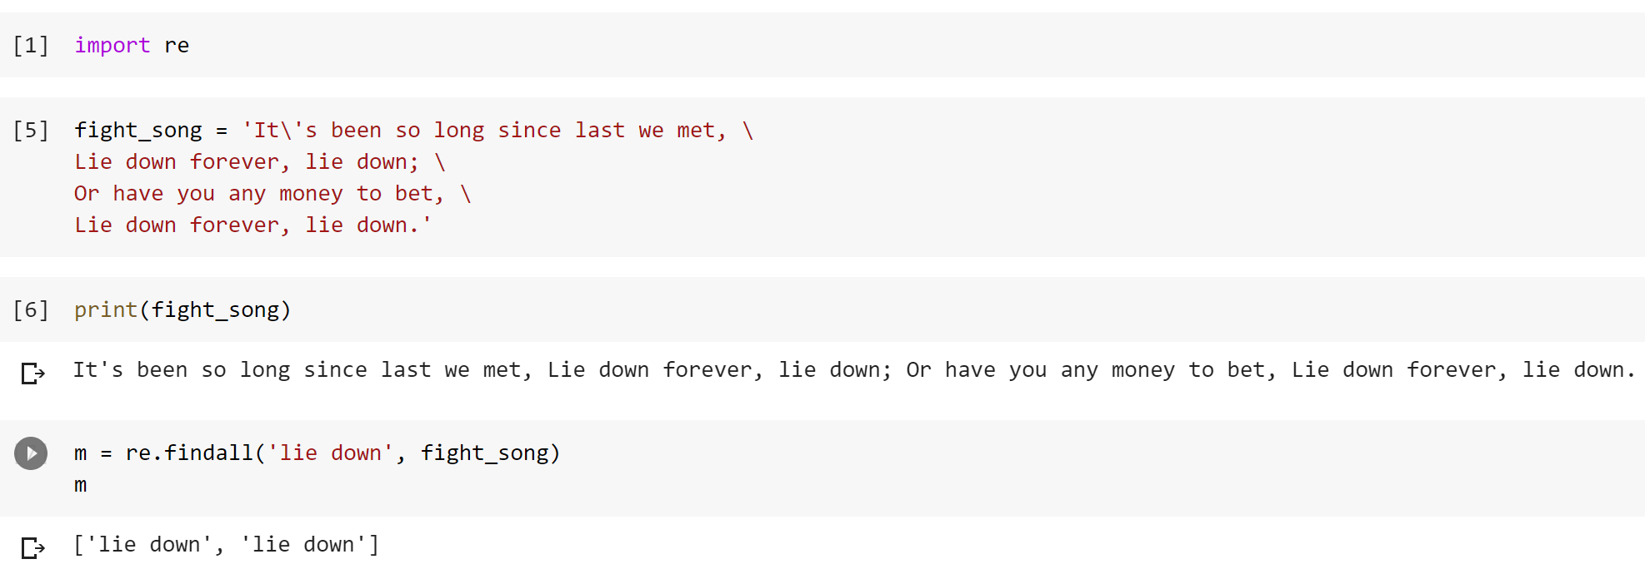
Ctrl F but make it Python!
Notes:
[Lauren] In this example we are going to use the findall method within re to help us find all strings which match “lie down” in the first stanza of the Georgetown fight song.
Can anyone spot on oddity about how many “lie down”s it caught? It only caught 2. Why?
A: Because it is looking for an EXACT match and only two of the lie downs are all lowercase. It is excluding the two “Lie down”s.

Slide 26
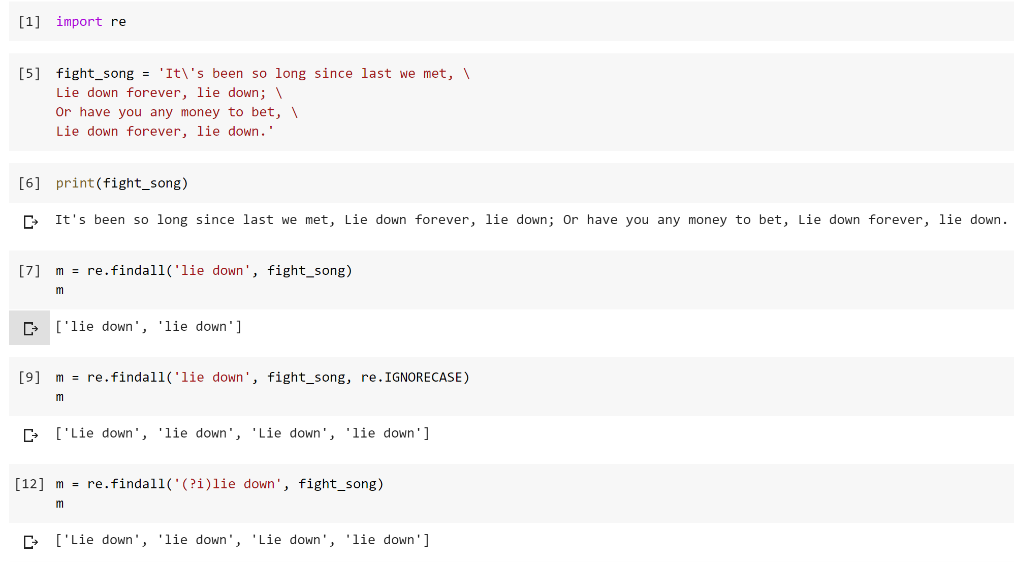
Let’s find all of the “lie down”s this time!
Notes:
[Lauren] Okay, so let’s try this again. On the screen we have two different examples of how to more accurately find all of the “lie down”s.
In the first example we use the simple findall and we do not actually get them all.
In the second example we use the IGNORECASE flag to tell the regex that we want to match on this string independent of the case. As you can imagine since we have learned about ASCII you know that lower down this has to now look for both an L (76) and an l (108). As well as the upper and lower case values of all of the other letters in the string.
Finally, if you wanted to use a regex character you can use ?i to turn on case insensitive mode at the beginning of the string.
Either way these last two approaches will get you all of the “(L/l)ie down”s.

Slide 27
Homework Practice Problem: Use a REGEX to refang / defang iocs

Slide 28
Python Standard Library

Slide 29
What is the Standard Library?
The standard library is a collection of modules and other components that are considered non-core but still extremely fundamental to Python. The standard library almost always comes packaged with Python on any default installation.
The library consists of:
Built-in functions and methods
Data Types and Exceptions
Modules, grouped into chapters by similarity
Some are written in C and built into the Python interpreter
Some are Python and imported in souce form
Some are designed for particular applications or operating systems

Slide 30
Why do we care? What’s in here?
string
re
Collections
datetime
Itertools
Many other modules...
Notes:
The standard library provides extensive functionality that is used for all Python programming. Knowing it well will help you implement more complex code (and get you through interviews).
Today we will briefly cover a number of key standard library modules that are worth exploring and learning. We’re going to give you pointers and a high-level understanding of what each module provides, but you will want to learn and explore far beyond what we’re covering today.
The more you learn and explore, the better prepared you will be for your projects, your final, and your career.

Slide 31
Infosec topic: ecrime & Information operations

Slide 32
Cyber Investigative disciplines
Espionage
Information Operations
eCrime
Advanced Persistent Threat (APT) actors aka well resourced, well organized organizations with political motivations typically aligned to nation state interests. Goal is typically to gain information or corrupt a technology asset.
An information operation is a campaign that is dedicated to obtaining a decisive advantage in the information environment aka influencing perceptions, views, opinions, etc.
Malicious cyber operations intended for financial gain.

Slide 33
IO: disinformation vs misinformation
Disinformation
Misinformation
False or misleading information which is spread deliberately to deceive.
False or misleading information which is spread without an intent to deceive.

Slide 34
Who has an active stake in the disinformation investigative ecosystem?
Media
Social Media
Governments
Centralized.
Can control and action the content which is on their platforms assuming they can see the content.
Decentralized.
Can generate leads for investigation but cannot action the findings of their investigations and generally need more data from the platforms to validate their findings.
Centralized.
Actively engage in disinformation creation. Track adversaries in the space and can action infrastructure but cannot generally action content.
Decentralized.
Generally talk about the actions of all of the above.
Decentralized.
Can only control the narrative they publish; therefore, cannot fix information ecosystem.
Track actors.
May be able to coordinate takedown of infrastructure but cannot generally action content because they do not own the platforms.
CTI Vendors / IT Companies
Investigative Journalists
Academia / Think Tanks

Slide 35
Approaches to address disinformation vs misinformation
Disinformation
Misinformation
Delete the information
Alert the user to the fact that they engaged with disinformation
Make your platform more annoying to the source of the disinformation to use so they go elsewhere.
Work with government to get the perpetrators indicted.
Education of the individual posting it and individuals opting in to consuming it.
Add friction to the content so it is less likely to be shared.
Add friction to consumption of the content.
Boost accurate info above it.

Slide 36
What does it take and what are the challenges to prove misinformation?
What does it take to prove misinformation?
What challenges exist with this approach?
Facts!
Assessments of truthiness
Ability to identify content which is similar but not exactly the same and a determination of whether or not that slightly different content is also true/untrue.
Identification of content across all modes of communication.
Need a source of facts and relative truthiness.
Identifying like content across text, images, video, audio, etc is very challenging.
Identify like content and determining truthiness in real time is presently impossible.

Slide 37
$$$ eCrime! $$$
Sophistication Levels Vary
Low Sophistication
High Sophistication
eCrime actors are generally thought of as less sophisticated but this is not universally true. Some APT actors (e.g. DPRK) engage in sophisticated eCrime and a handful of nationstates (e.g. Russia) knowingly allow sophisticated eCrime actors to operate within their borders and do not intervene.
Script kiddies
Carders
Affiliates
Ransomware-as-a-Service providers

Slide 38
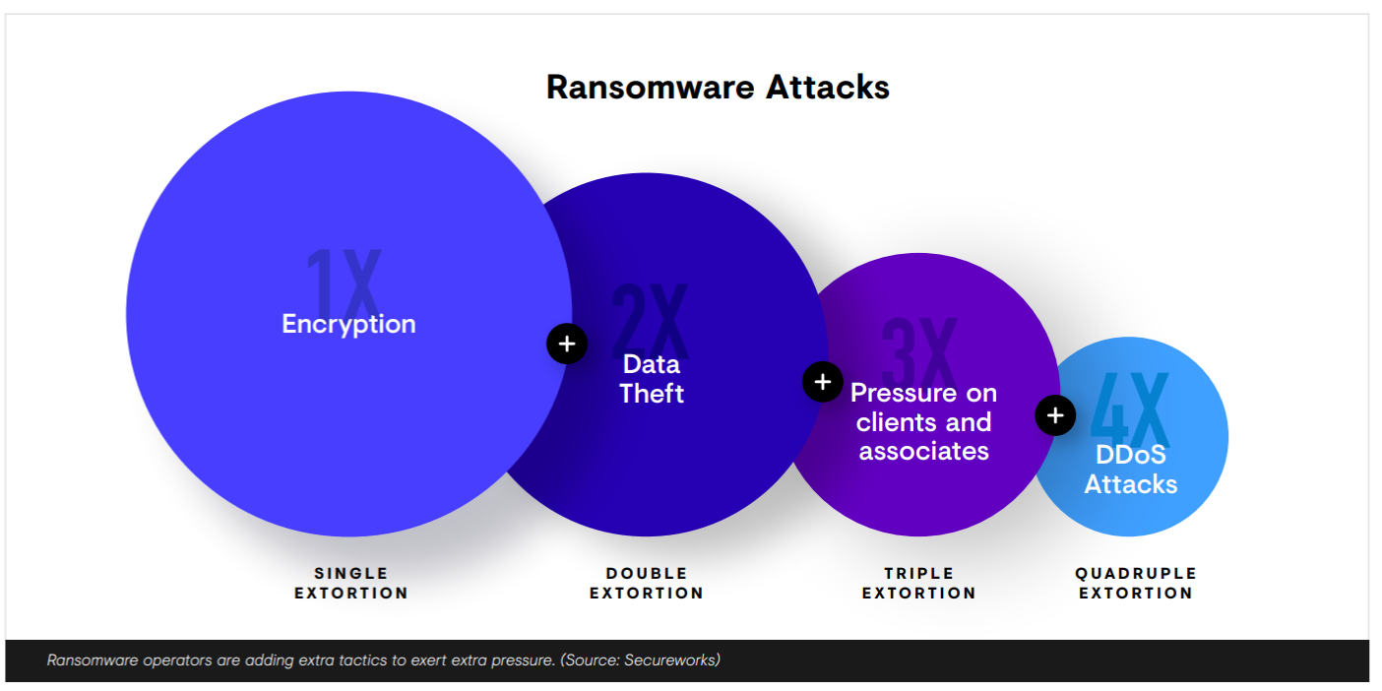
$$$ Ransomware! $$$

